Slide 1
Beyond the Five Senses

Slide 2
Note: After you download the slideshow, you may also need to download some videos from YouTube & add them into this PowerPoint. This tool can help you: Free YouTube Downloader
We present these messages in outdoor venues using the SonShineTent. Watch the video of our service that goes with this message, click here: http://campaignkerusso.org/?p=11244
We would love to know more about the people who download our lessons & sermons. We invite you to email us & let us know where & how you use them.
info@campaignkerusso.org

Slide 3
Welcome All

Slide 4
Let’s Begin with Prayer

Slide 5
Beyond the Five Senses

Slide 6
Deep Dissatisfaction Makes us Seek more and more!
We are unhappy and long to…

Slide 8
If not something from without, we search for more within.

Slide 9
We seek temporary escape through books…

Slide 10
…or movies.

Slide 11
Seeking for “more” starts at a very early age.

Slide 12
…and continues throughout our lives.

Slide 13
The search begins here:
Sight
Smell
Taste
Touch
Hearing

Slide 14
Yet there is far more…
Beyond the Five Senses
A Sense of Right and Wrong
A Sense of Truth
A Sense of Eternity

Slide 15
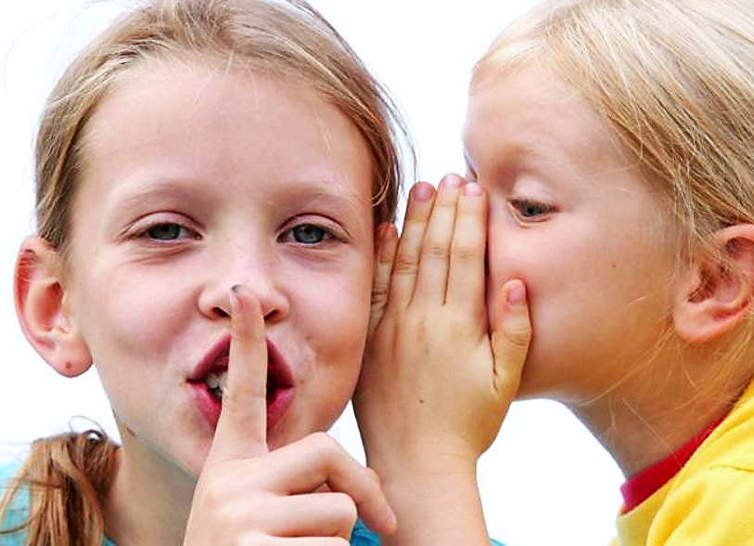
A Sense of Right and Wrong
Studies show that babies are born with a sense of right and wrong.

Slide 16
Video: Do Babies Know Right from Wrong?
Video Goes Here Title: Do Babies Know
Right from Wrong? Download Here:
http://youtu.be/DSs1Kh2jxJM

Slide 17
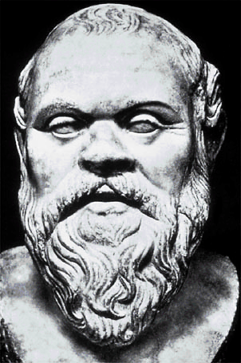
Socrates
“The greatest good of a man is daily to converse about virtue… examining myself and others… the life which is unexamined is not worth living”
Charged with “corrupting the youth of Athens,” he
he willingly accepted his own death sentence by drinking poison.

Slide 18
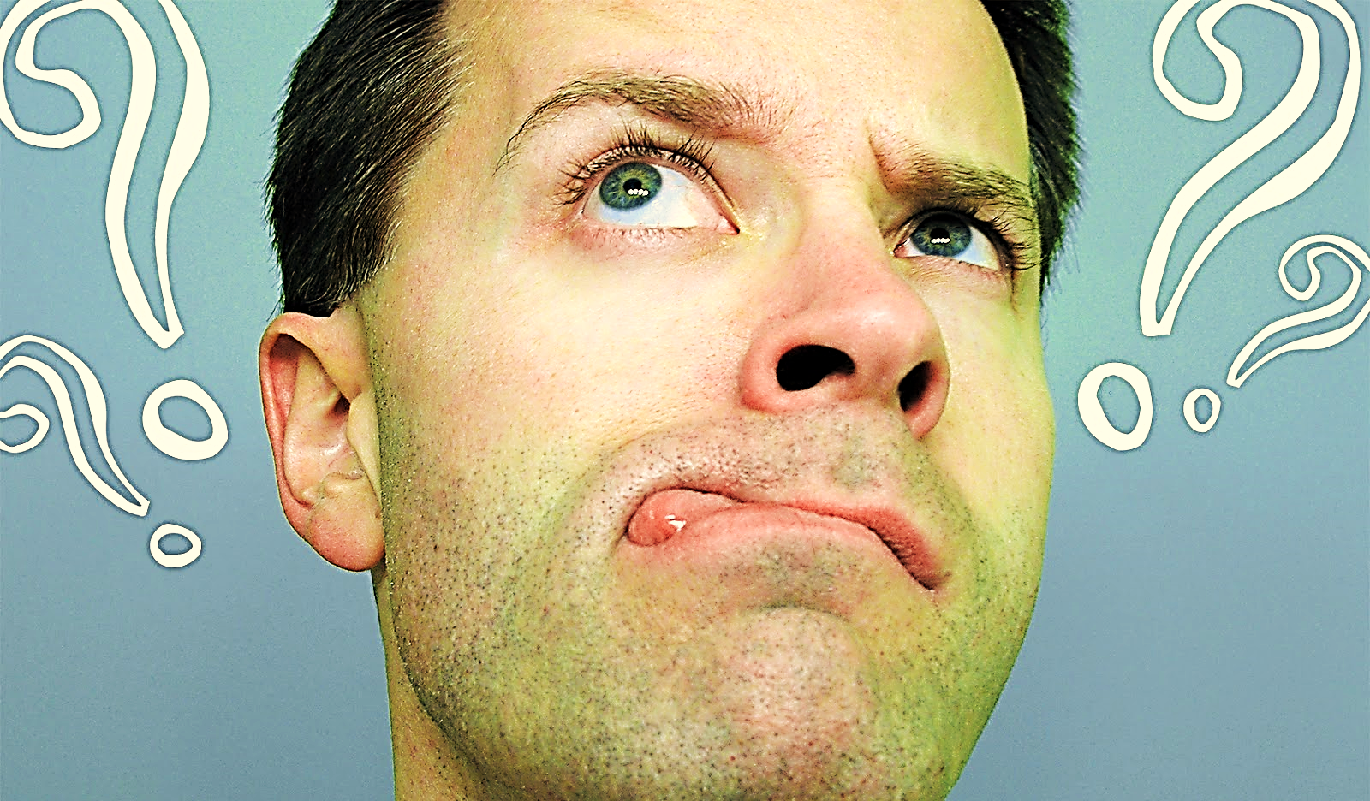
A Sense of Right and Wrong is Inside Us
“So I find this law at work: When I want to do good, evil is right there with me.” Rom. 7:21

Slide 19
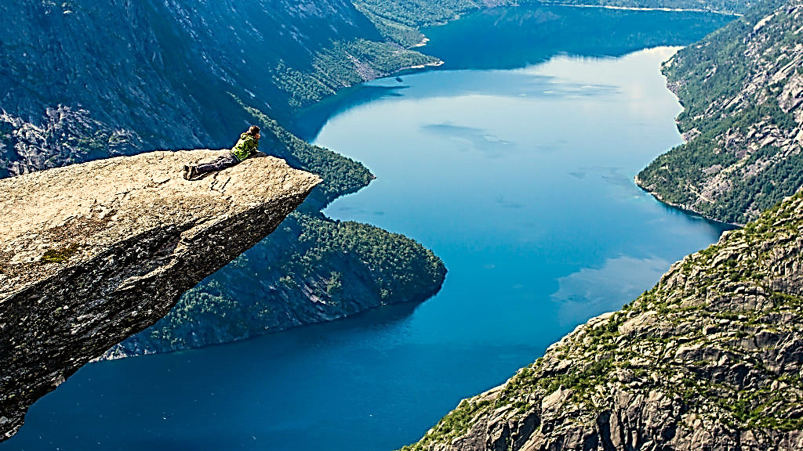
A Sense of Eternity

Slide 20
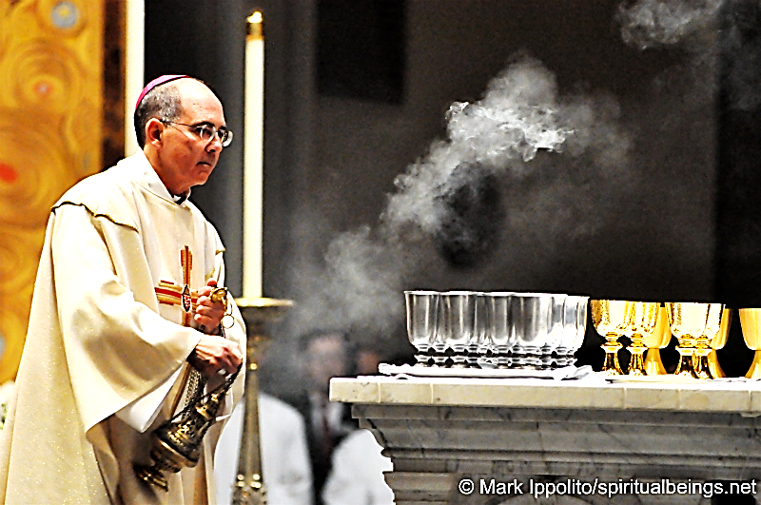
Many search for the eternal in
traditional forms of worship.

Slide 21
Some search
through meditation.

Slide 22
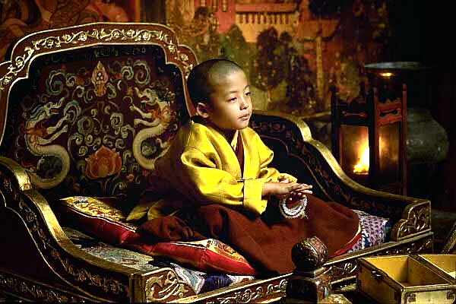
Others search through worshiping this small child.

Slide 23
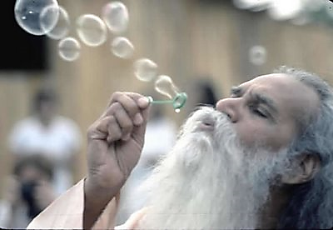
Or sometimes this old man.

Slide 24
Some worship nature.

Slide 25
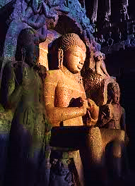
Others worship stone idols.

Slide 26
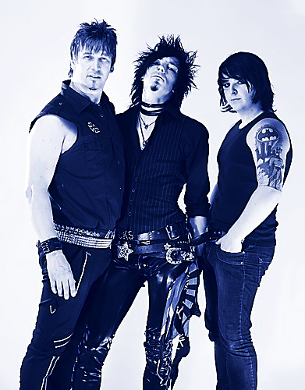
Here is a band who are actually called “The Stone Idols.”

Slide 27
Some may try worship-ping the spirits of animals.

Slide 28
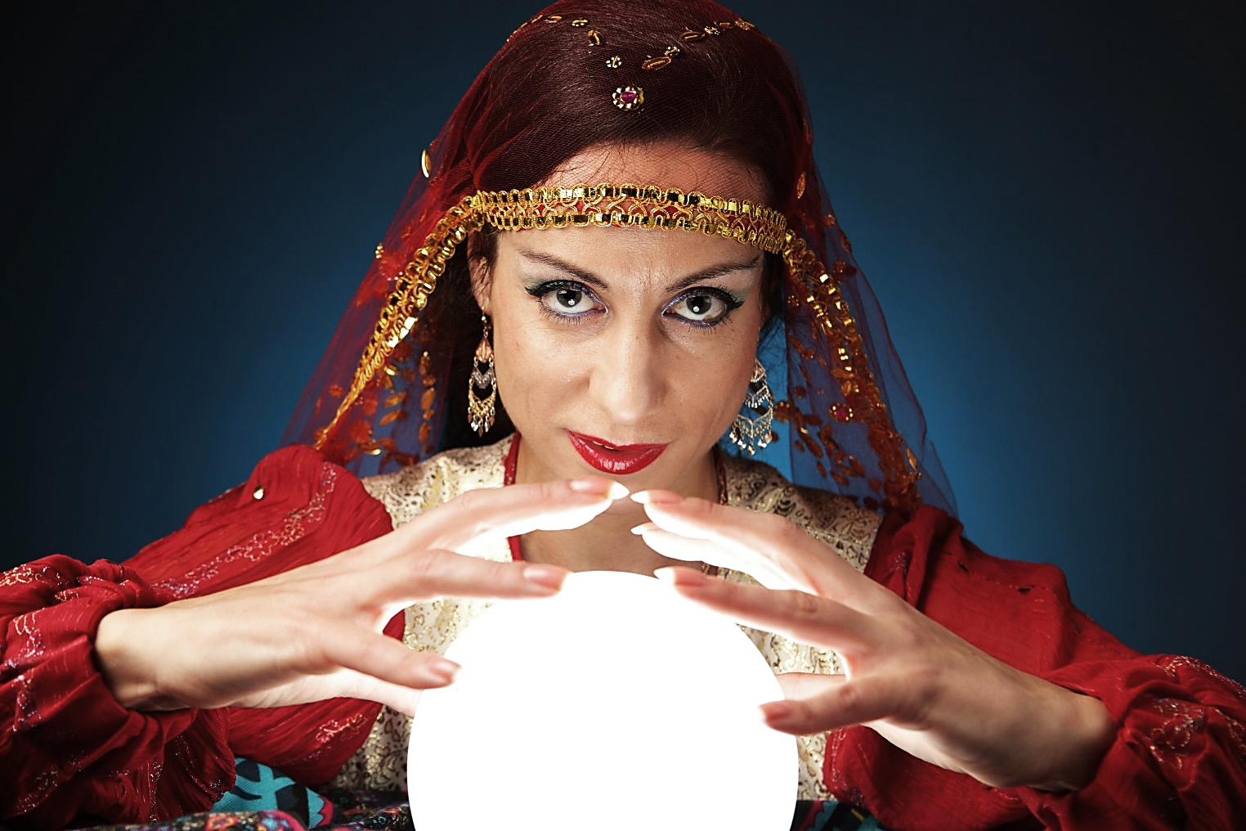
Others try contacting the
spirits of the departed.

Slide 29
What is the answer?
Is anybody really out there?

Slide 30
Solomon, in Eccl. 3:11 gives us quite an explanation for this apparent universally shared feeling of dissatisfaction.
Solomon says: “[God] has put a sense of eternity in people’s minds. Yet, mortals still can’t grasp [the fullness of] what God is [and has been] doing from the beginning to the end of time.”

Slide 31
The answer of the
atheist and the foolish:

Slide 32
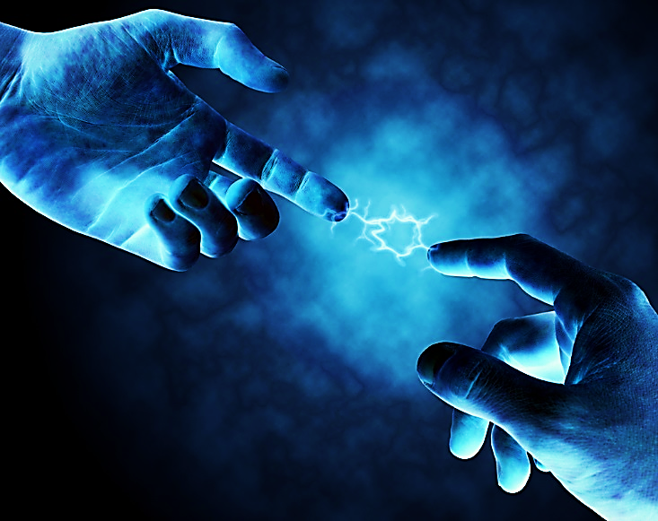
But we know in our heart of hearts
there Is a connection to someone
BIGGER THAN OURSELVES!!!
Which leads us to this:

Slide 33
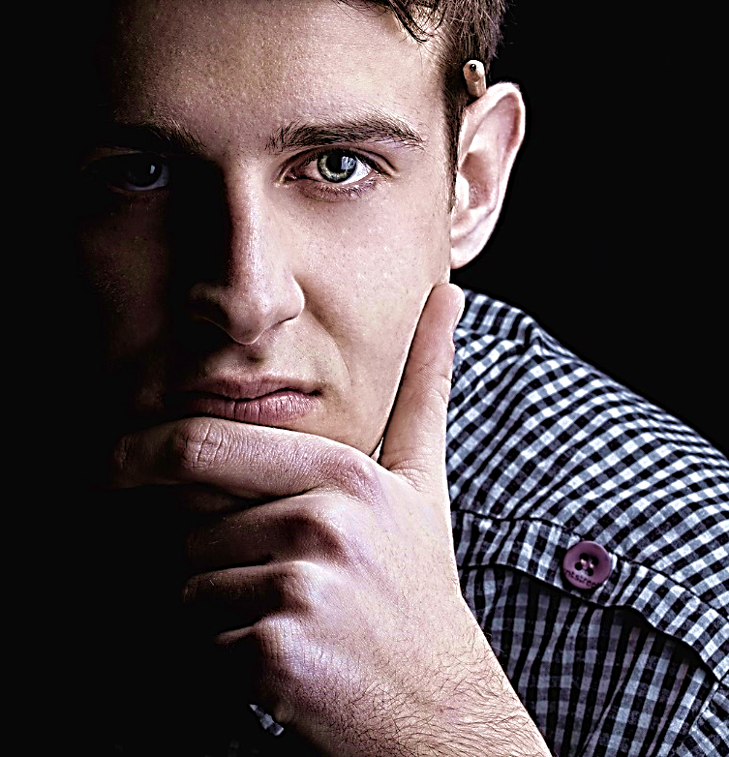
A Sense of Truth

Slide 34
What are we to believe?
Are there many truths, or is there one truth?
Yet, we know in our hearts that there can be only one truth!

Slide 35
In the gospel of John chapter 14, Jesus speaks these words to some of His disciples:
“Do not let your hearts be troubled. You believe in God; believe also in Me.”

Slide 36
Jesus declared that He IS the universal, one & only, big TRUTH!

Slide 37
Heb. 3:1-3 “In the past God spoke to our ancestors many times and in many ways through the prophets..”

Slide 38
“..but in these last days he has spoken to us through His Son..”

Slide 39
“…He is the one through whom God created the universe, the one whom God has chosen to possess all things at the end…”

Slide 40
“..He reflects the brightness of God's glory and is the exact likeness of God's own being..”
“..sustaining the universe with His powerful word..”

Slide 41
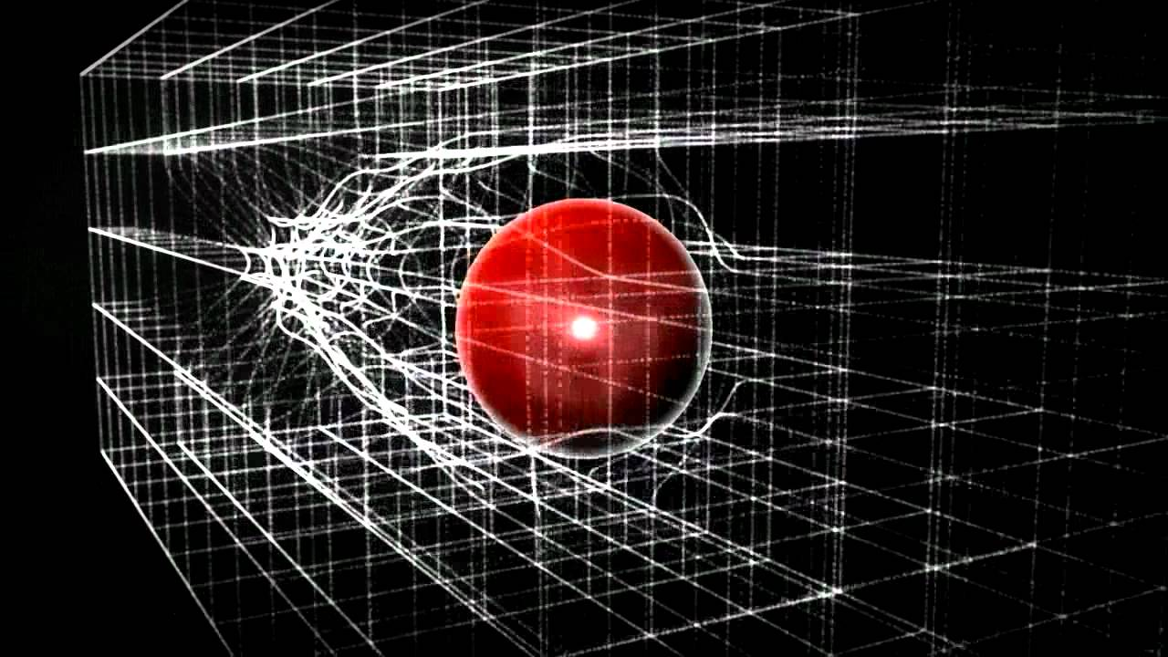
“Sustaining the Universe with His Powerful Word…” Wow!
Did you know:
Scientists believe there is a mysterious field in the universe that holds everything together. Without it, everything would fly apart. They call it the “Higgs Field.”
It is made up of particles called, “Higgs Boson Particles.” Scientists refer to these as the “God Particles.” (Isn’t that interesting?)

Slide 42
“..After achieving forgiveness for the sins of all human beings,..”

Slide 43
“…He sat down in heaven at the right side of God, the Supreme Power…”Heb.3:1-3
Jesus is the Truth

Slide 44
Song: Jesus
Video Goes Here Title: Jesus Download Here:
https://youtu.be/cEbQswNB6Wc

Slide 45
We are God’s creation
but we have gone our own way.
Resulting in:
Twisted sense of right and wrong
The truth is no longer clear
Our connection to eternity is severed
Notes:
Romans 5:5 ..”God’s love has been poured out into our hearts..”
Deut 6:6 “These commandments that I give you today are to be on your hearts”
Gen 1:26,27 “Then God said, “Let us make mankind in our image, in our likeness..
So God created mankind in his own image, in the image of God he created them;
male and female he created them.

Slide 46
The Way Back
Turn from Sin
Choose Life
Accept Jesus

Slide 47
Is Jesus
Speaking to You?
“They said to each other, ‘Did not our hearts burn within us while he talked to us on the road, while he opened to us the Scriptures?’”
John Wesley Said:
“…the preacher was describing the change which God works in the heart through faith in Christ and I felt my heart strangely warmed.”
Jesus makes His presence Known by a small voice!

Slide 49
What is the Sinner‘s Prayer?
This is a prayer we can pray when we are ready to admit we are sinners and need Christ’s forgiveness.
It must be prayed with faith in our hearts and a readiness to have a life-changing encounter with Jesus Christ.

Slide 50
A prayer of faith → Pray this prayer if :
If you never have before
You have in the past, but you think it would mean more today
You have been walking afar off and you want to come back
You want to set an example & show others how it is done
You just like to give your heart to Jesus again & again
Faith

Slide 51
We Declare Our Faith Publicly Because Jesus Declared His LOVE Publicly
“If you stand before others and are willing to say you believe in me, then I will tell my Father in heaven that you belong to me.” Mat 10:32
If you are ready to give your heart & life to Jesus right now, please come to the front as we pray this prayer together.

Slide 52
Three Important Questions
Do you want to know Jesus as your Savior right now?
Do you believe He died to save you from your sins & that He rose from the dead?
Do you believe that He is here, waiting to save you right now?

Slide 53
The Prayer of a Sinner Turning to Jesus
Dear Jesus, I know that I have sinned against You and that my sins separate me from You.
I am truly sorry.
Right now, I turn away from my sinful past .
Please forgive me, and help me to keep from sin.
I believe You died for my sins.
I Believe You rose from the dead, you are alive, and you hear this prayer from my heart.
I invite You Jesus to be both my Savior and the Lord of my life.
I want You to rule my life from now on.

Slide 54
“But some people did accept him. They believed in him, and he gave them the right to become children of God.”
John 1:12

Slide 56
“If you openly say, ‘Jesus is Lord’ and believe in your heart that God raised him from death, you will be saved.”
Rom. 10:9
What did you learn today?
What about our senses of right & wrong, eternity and truth ?
What have you been thinking about God lately?
What do you want to tell others about Jesus?

Slide 57
Let’s Close in Prayer

Slide 58
Note: After you download the slideshow, you may also need to download some videos from YouTube & add them into this PowerPoint. This tool can help you: Free YouTube Downloader
We present these messages in outdoor venues using the SonShineTent. Watch the video of our service that goes with this message, click here: http://campaignkerusso.org/?p=11244
We would love to know more about the people who download our lessons & sermons. We invite you to email us & let us know where & how you use them.
info@campaignkerusso.org

